Slide 1


Ninh Hiep Primary School
Welcome to our class 4E
Teacher: Nguyen Van Long

Slide 2


Friday, February 17th 2017
Unit 14: What does he look like?
Revision - Lesson 3
Listen, point and say.
Listen and write.
3.Draw and write
4. Let’s sing

Slide 3




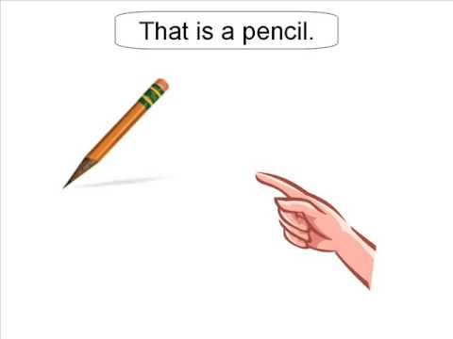




1
Listen
Point
Say
earth /ə:θ/
thin /θin/
three /θri:/
this /ðis/
weather /'weθə/
that /ðæt/

Slide 4
2. Listen and write
interesting
This is my book. It’s…...………….
2. My mother is …………….. and ……………..
3. His brother is taller……………. his sister
4. The ……………. is beautiful today.
5. …………… are four people in my family
tall
beautiful
than
weather
There

Slide 5
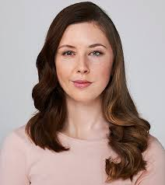
3. Draw and write about your mom
Hello. This is my …...………….
Her name’s ….……………..
She’s a/an …………………
She’s …………….. and ……………
She likes ……………………
Her favorite…………………..

Slide 6

4. Let’s sing

Slide 7
SUMMARIZE
SOUNDS
“TH” : θ
ð
2. FORM
What does he / she look like?

Slide 8



HOMEWORK:
Make questions and answers
“What do/ does…….. Look like?”
Prepare new lesson.

Slide 9




goodbye and see you again .
Thank you for your attention!

